Slide 1

ML
A Tool for Managing the Machine Learning Lifecycle

Slide 2
contents
What is MLflow?
ML Pipeline Lifecycle
MLflow Components
Video
Integrations
Architecture
Do We Need a DB?
MLflow Tracking UI
Code Example
With or Without
Benefits vs Challenges
Real-World Usage
When Not To Use
Resources

Slide 3
How do we currently track experiments?
Introduction
Goal: Can MLflow improve our workflow?

Slide 4
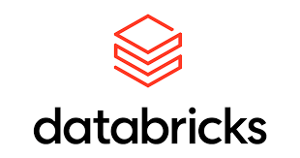
What is MLflow?
Open-source platform for managing ML lifecycle.
Created by Databricks.
Supports Python, R, Java.

Slide 5
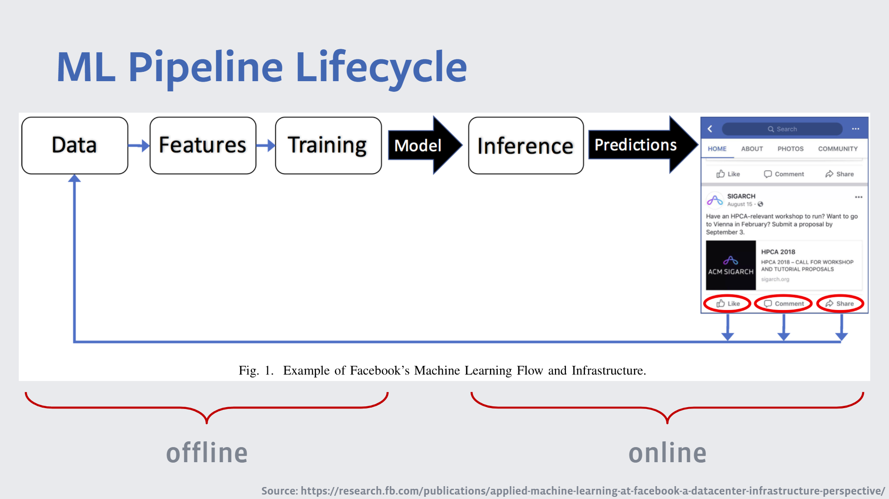

Slide 6
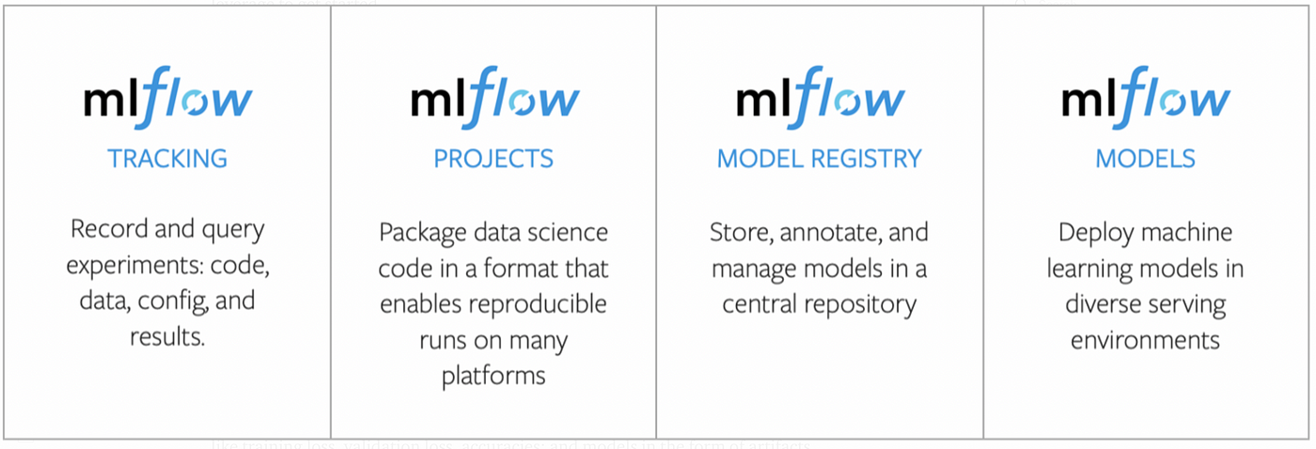
MLflow Components
Foundation

Slide 7
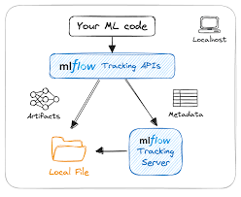
MLflow Tracking
Log parameters, metrics, artifacts, models.
UI for comparing experiments.
REST API, CLI, Python SDK.

Slide 8
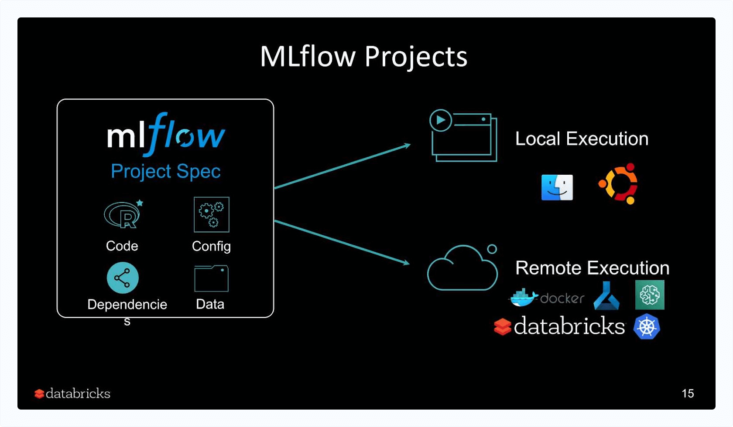
MLflow Projects
Standardized packaging of ML code.
Uses MLproject file.
Supports Conda and Docker environments.

Slide 9
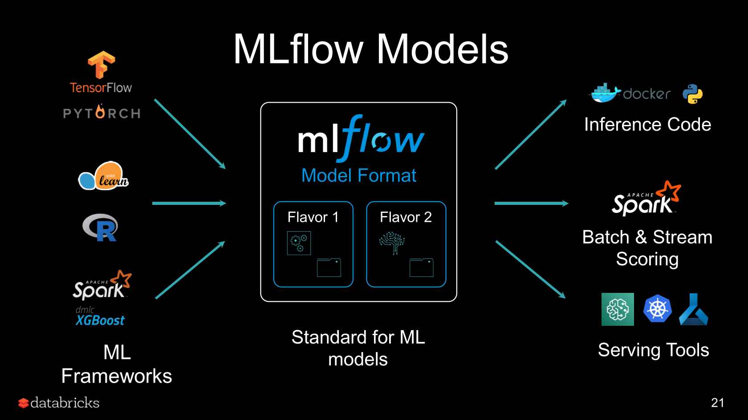
MLflow Models
Format abstraction for deployment.
Supports many ML libraries.
'Package once – deploy anywhere'.

Slide 10
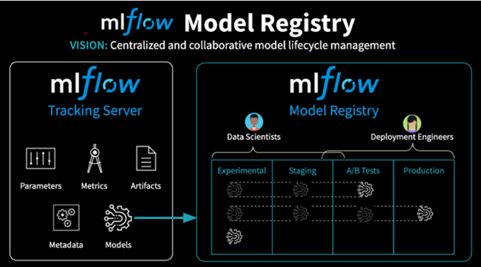
MLflow Model Registry
Central store for models.
Model versioning, approval stages, CI/CD integration

Slide 11

Let’s watch a Video

Slide 12
Integrations
ML Libraries & Frameworks:
Scikit-learn, TensorFlow,
PyTorch, XGBoost, and more.
Data & Storage:
Amazon S3, Azure Blob Storage,
Google Cloud Storage, or local file systems.
CI/CD Workflow Tools:
GitHub Actions, Jenkins, Airflow, and Kubeflow
Model Serving & Deployment:
Docker, Kubernetes, Azure ML, SageMaker, and Databrick,
Rest API
Visualization & Monitoring:
TensorBoard, Prometheus,
and Grafana

Slide 13
Architecture
Tracking Server – Logs and queries experiments.
UI – Web interface to visualize runs and metrics.
Artifact Store – Stores models, datasets, and output files (e.g., S3, GCS, local).
Backend Store – Stores metadata (e.g., SQLite, MySQL, PostgreSQL).
Can be self-hosted or used via managed platforms (e.g., Databricks, Azure ML).

Slide 14
Does MLflow Require a Database?
MLflow can use a database—but it's not strictly required for basic use. By default, MLflow uses a local file system to store experiment metadata and artifacts. However, for team collaboration, centralized tracking, and scalability, integrating a backend database like MySQL, PostgreSQL, or SQLite is strongly recommended. This allows multiple users to track experiments, share results, and manage models in a consistent way across environments.

Slide 15
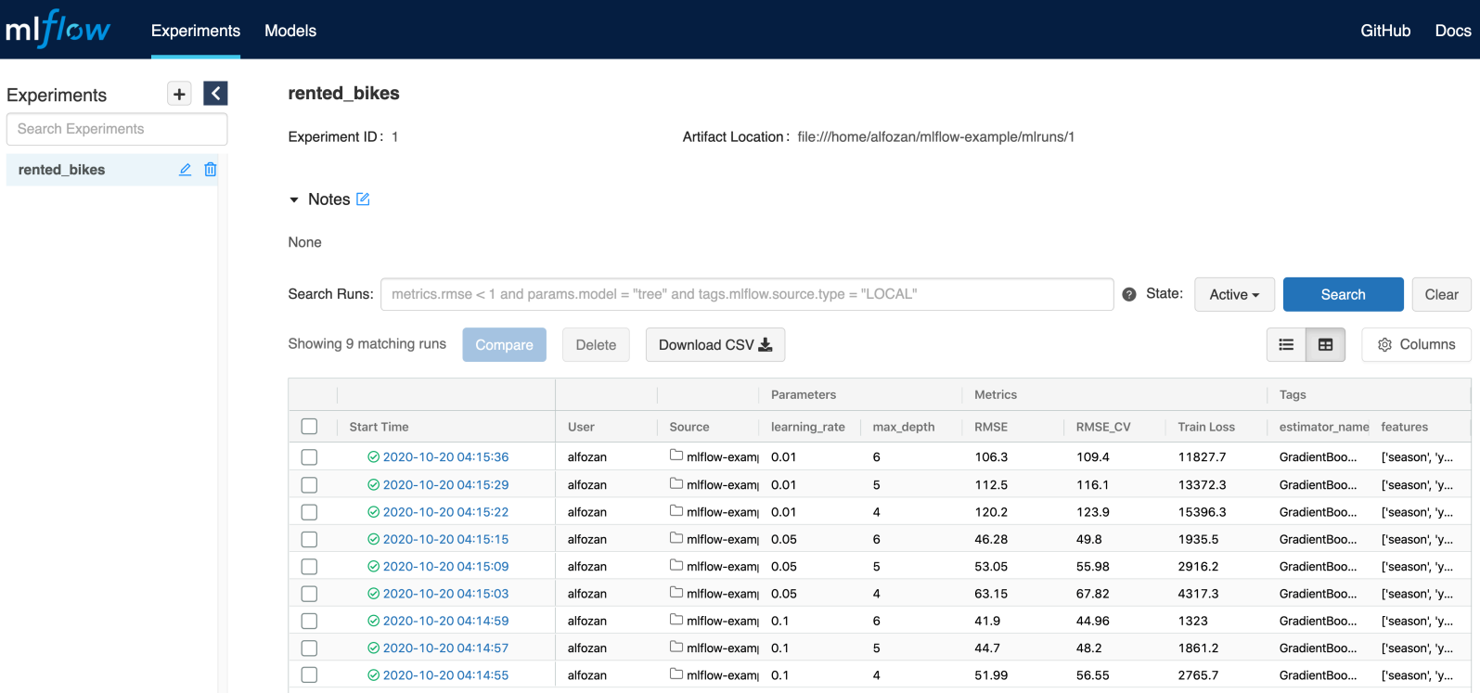
Mlflow tracking ui

Slide 16
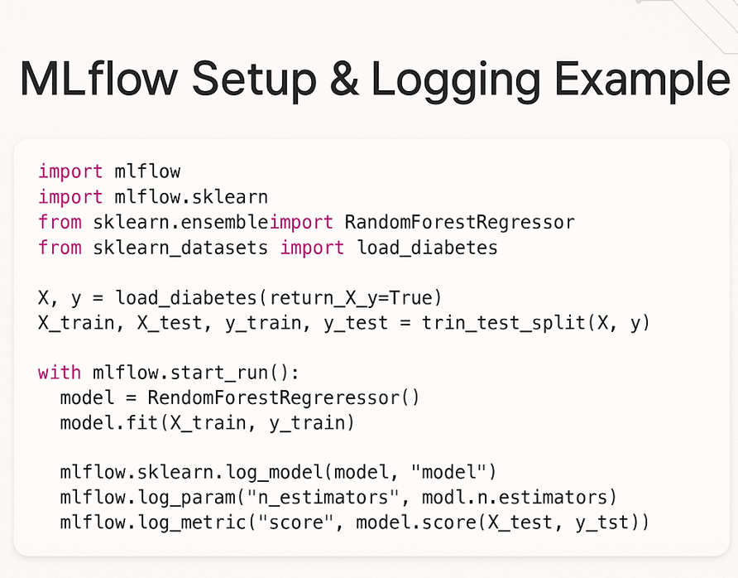
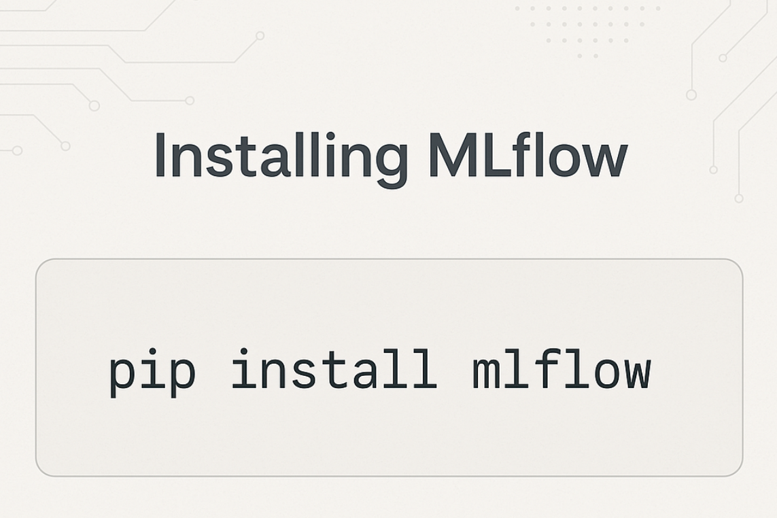
Code Example

Slide 17
With or Without
Without MLflow | With MLflow
Manual tracking with notebooks/files. | Centralized and automatic tracking.
Hard to reproduce. | Easier debugging and comparison.
Difficult collaboration. | Improved collaboration.
With MLflow: Organized, Reproducible, Scalable
Without it: Chaos in Experiments.

Slide 18
Benefits vs Challenges
Reproducibility | Hosting infrastructure
Comparison of experiments | Learning curve
Integration with CI/CD | Not a full MLOps solution alone

Slide 19
Real-World Usage
Used by:
Databricks - Creators of MLflow; use it as a core part of their ML platform.
Airbnb - Uses MLflow to standardize model tracking across teams
Microsoft - Integrates MLflow with Azure Machine Learning to provide flexible experiment tracking and model deployment.
Facebook - Applies MLflow in internal workflows to streamline model development and deployment
Example – Finance: Used to manage experiments for fraud detection, credit scoring, and algorithmic trading.

Slide 20
When NOT to Use
Small projects
Simple experimentation
No need for reproducibility

Slide 21
Resources
https://mlflow.org
GitHub: https://github.com/mlflow/mlflow
Docs, tutorials, examples
https://youtube.com

Slide 22
THANK YOU
PREPARED BY:
gaLINA K. gEORGIEVA

